Slide 1
WIRELESS EMBEDDED SYSTEM Introduction to IoT
2/28/2022

Slide 2
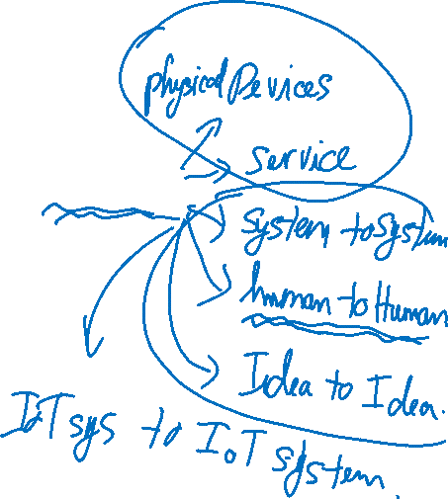
What is Internet of Things?

Slide 3
What is IoT?

Slide 4

Smart Things

Slide 5
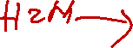

Slide 6
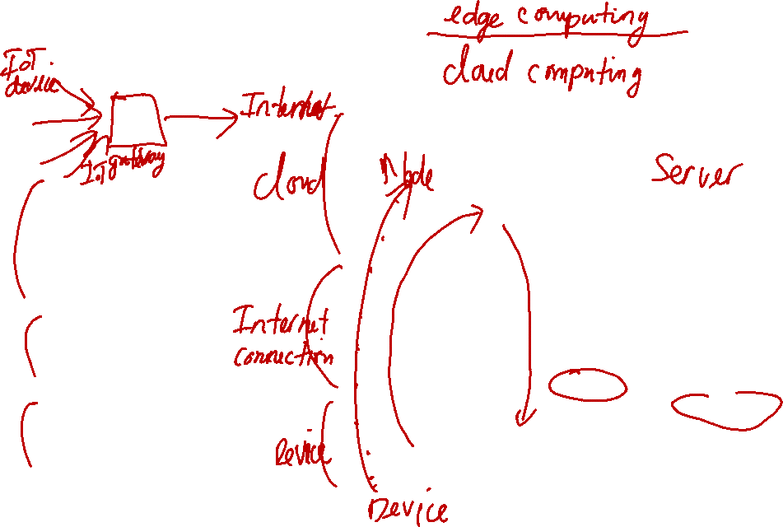
The Needs for IoT
Sensors
Local Processing
Local Storage
Network
Internet
Cloud Processing
Cloud Storage

Slide 7
Sensors
Measure values
Send raw data
Low power consumption
Examples Motion
Temperature
Speed
Humidity
Light
...

Slide 8
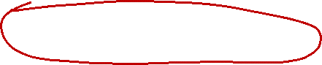
Local Processing and Storage
Collect the data from the sensor
Process it
Compress
Sample
Analyze
Send the data
Edge Device/Fog Computing

Slide 9
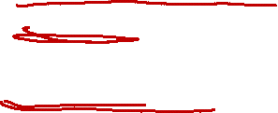
Network and Internet
IOT Gateway: The connection point between IoTdevices and the cloud.
Aggregates sensor data
Translates between sensor protocols
Processes sensor data before transmition.
…
Protocols HTTP, XMPP, MQTT, ZigBee
Wi-Fi, Bluetooth, Ethernet
…
Coutrsy:www.mentor.com

Slide 10

Cloud Processing and Storage
Ubiquitous access to shared resources
Computer networks, servers, storage, applications and services
Configurable
Cost reductions.
Multitenancy
Centralization of infrastructure
Handling peak-load capacity
Utilization and efficiency improvements
Device and location independence
Simplify Maintenance and Recovery
Scalability and Security

Slide 11
Cloud Processing and Storage
Data Aggregate
Data Analysis
Inference and Learning
Storing Data
Control applications

Slide 12

Q&A

